Slide 1
“EMAILS SPAM CLASSIFIER” PROJECT PRESENTATION
By Mr. Krishna Teja Dinavahi
Fliprobo – Internship 31
FLIPROBO SME: Ms. Gulshana Chaudhary

Slide 2
Agenda
Problem Statement.
Problem Understanding.
Motivation for the problem undertaken.
Data Pre-processing Done.
Exploratory data analysis.
Data Balancing.
Model Building.
ROC AUC Curve.
Interpretation of the results.
Hyper Parameter Tuning.
Saving the model and predictions from saved best model.
Conclusion.

Slide 3
Problem Statement
The SMS Spam Collection is a set of SMSs tagged messages that have been collected for SMS Spam research. It contains one set of SMS messages in English of 5,574 messages, tagged according being ham (legitimate) or spam.
What is a Spam Filtering? Spam Detector is used to detect unwanted, malicious and virus infected texts and helps to separate them from the no spam texts. It uses a binary type of classification containing the labels such as ‘ham’ (no spam) and spam. Application of this can be seen in Google Mail (GMAIL) where it segregates the spam emails in order to prevent them from getting into the user’s inbox.
The files contain one message per line. Each line is composed by two columns: v1 contains the label (ham or spam) and v2 contains the raw text.

Slide 4
Problem Understanding
Predictive modelling, Classification algorithms are some of the machine learning techniques used along with the various libraries of the NLTK suite for Classification of comments. Using NLTK tools, the frequencies of malignant words occurring in textual data were estimated and given appropriate weightage, whilst filtering out words, and other noise which do not have any impact on the semantics of the comments and reducing the words to their base lemmas for efficient processing and accurate classification of the comments.

Slide 5
Motivation for the Problem Undertaken
Email has become one of the most important forms of communication. In 2014, there are estimated to be 4.1 billion email accounts worldwide, and about 196 billion emails are sent each day worldwide. Spam is one of the major threats posed to email users. In 2013, 69.6% of all email flows were spam. Links in spam emails may lead to users to websites with malware or phishing schemes, which can access and disrupt the receiver’s computer system. These sites can also gather sensitive information from. Additionally, spam costs businesses around $2000 per employee per year due to decreased productivity. Therefore, an effective spam filtering technology is a significant contribution to the sustainability of the cyberspace and to our society.
So that we need to do spam filtering so user more user friendly. From above model building we got the Complement Naive Bayes Classifier is a best model deciding whether the emails have spam or not.

Slide 6
Data Pre-processing Done
Rows with null values were removed.
Columns: Unnamed: 0(just a series of numbers) was dropped since it doesn't contribute to building a good model for predicting the target variable values.
The train and test dataset contents were then converted into lowercase.
Punctuations, unnecessary characters etc. were removed, currency symbols, phone numbers, web URLs, email addresses etc. were replaced with single words
Tokens that contributed nothing to semantics of the messages were removed as Stop words. Finally retained tokens were lemmatized using WordNetLemmatizer().
The string lengths of original comments and the cleaned comments were then compared.

Slide 7
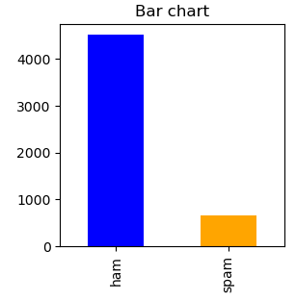
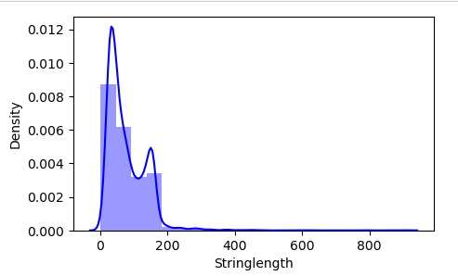
Exploratory Data Analysis
Observation:
We can see the label is not balanced wo we need balanced it.
we can see most of the emails are lies between 0 to 200 words.

Slide 8
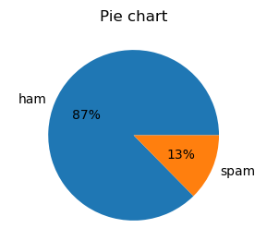
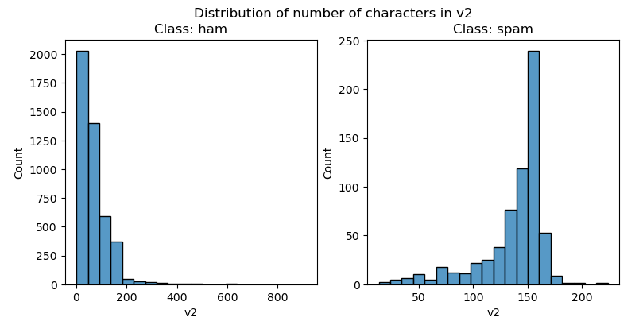
Observation:
We can see, the 13.4% of emails is spam but 86.6. But 86.6% emails are non-spam(ham).
We can see, that non-spam emails are lies between the 0 to 200 characters mostly. Spam emails characters mostly lies between the 110 to 160.

Slide 9
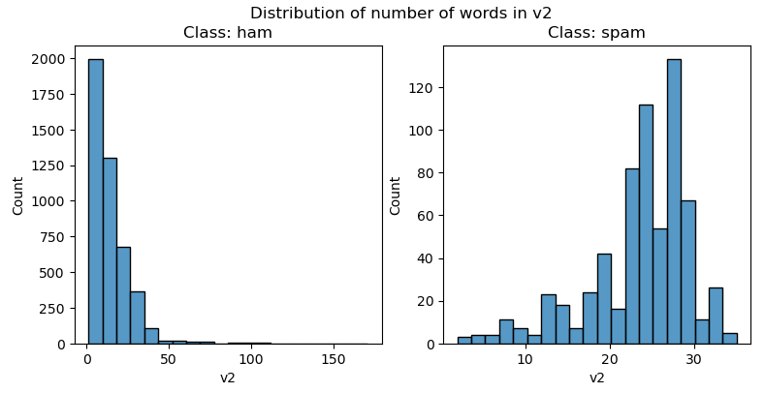
Observation:
The non-spam words in emails mostly lies between 0 to 30.
But in spam mostly number of words lies in between 20 to 30.

Slide 10
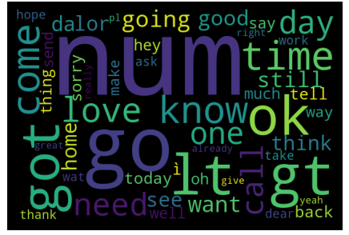
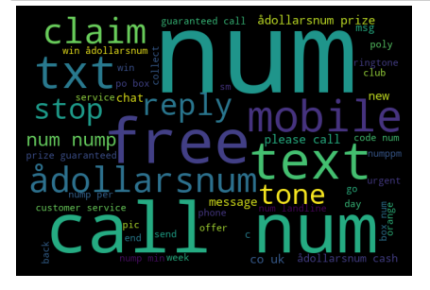
Observations:
We can see, so many emails are not spam. num, ok, love, need and come these are the word are mostly used.
We can see, spam emails words that are mostly used as show above. txt, call, claim, adollarsnum and mobile these are the words are mostly used.

Slide 11

Data Balancing
One approach to addressing imbalanced datasets is to oversample the minority class. The simplest approach involves duplicating examples in the minority class, although these examples don’t add any new information to the model. Instead, new examples can be synthesized from the existing examples. This is a type of data augmentation for the minority class and is referred to as the Synthetic Minority Oversampling Technique, or SMOTE for short.

Slide 12
Model Development and Evaluation
Logistic Regression: It is a classification algorithm used to find the probability of event success and event failure. It is used when the dependent variable is binary (0/1, True/False, Yes/No) in nature. It supports categorizing data into discrete classes by studying the relationship from a given set of labelled data. It learns a linear relationship from the given dataset and then introduces a nonlinearity in the form of the Sigmoid function. It not only provides a measure of how appropriate a predictor (coefficient size) is, but also its direction of association (positive or negative).
XGBClassifier: XGBoost uses decision trees as base learners; combining many weak learners to make a strong learner. As a result, it is referred to as an ensemble learning method since it uses the output of many models in the final prediction. It uses the power of parallel processing and supports regularization.

Slide 13
Model Development and Evaluation
RandomForestClassifier: A random forest is a meta estimator that fits a number of classifying decision trees on various sub-samples of the dataset and uses averaging to improve the predictive accuracy and control over-fitting. A random forest produces good predictions that can be understood easily. It reduces overfitting and can handle large datasets efficiently. The random forest algorithm provides a higher level of accuracy in predicting outcomes over the decision tree algorithm
Complement Naïve Bayes Classifier: Complement Naive Bayes is somewhat an adaptation of the standard Multinomial Naive Bayes algorithm. Complement Naive Bayes is particularly suited to work with imbalanced datasets. In complement Naive Bayes, instead of calculating the probability of an item belonging to a certain class, we calculate the probability of the item belonging to all the classes.

Slide 14
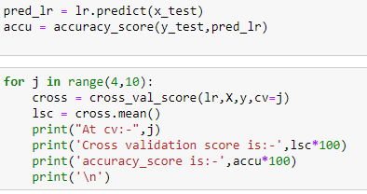
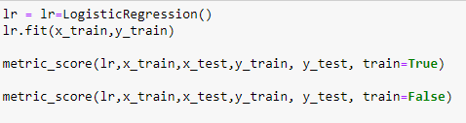
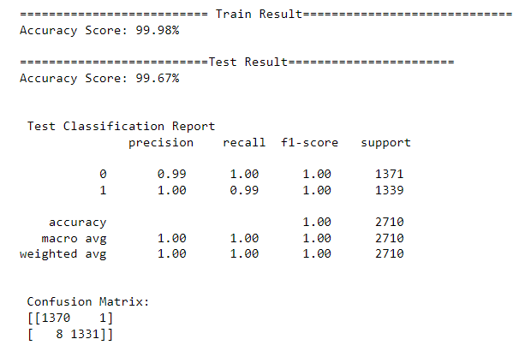
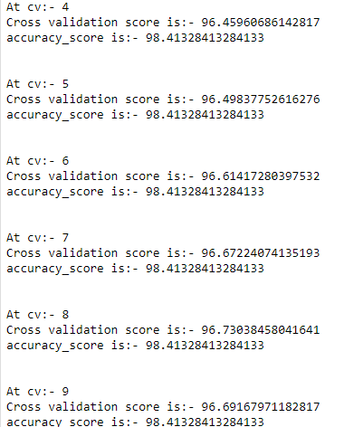
Cross Validation for Logistic Regression:
Logistic Regression:

Slide 15
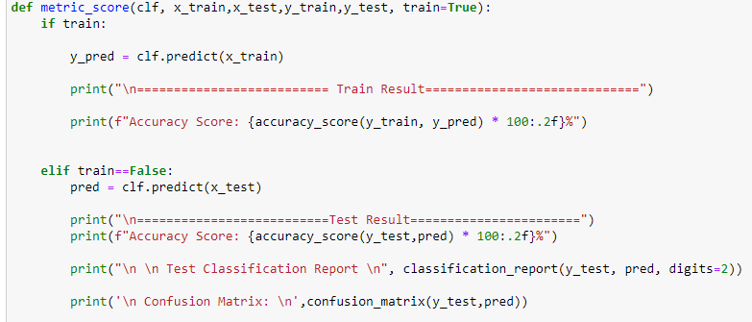
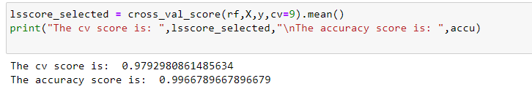
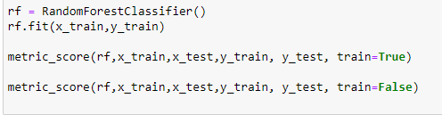
Random Forest Classifier:

Slide 16
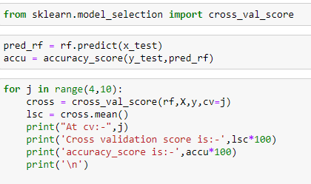
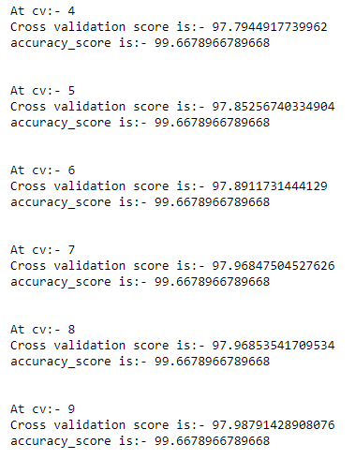
Cross Validation For Random Forest Classifier

Slide 17
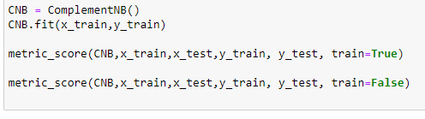
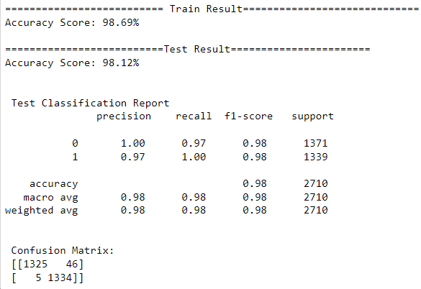
Complement Naïve Bayes:

Slide 18
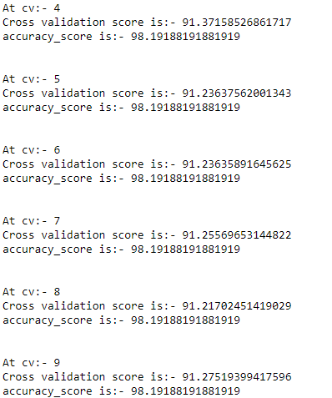
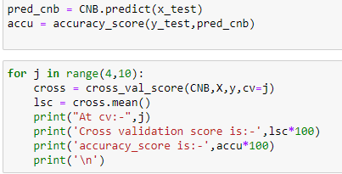
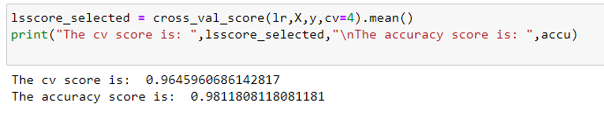
Cross Validation For Complement Naïve Bayes:

Slide 19
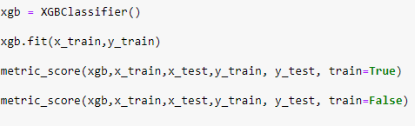
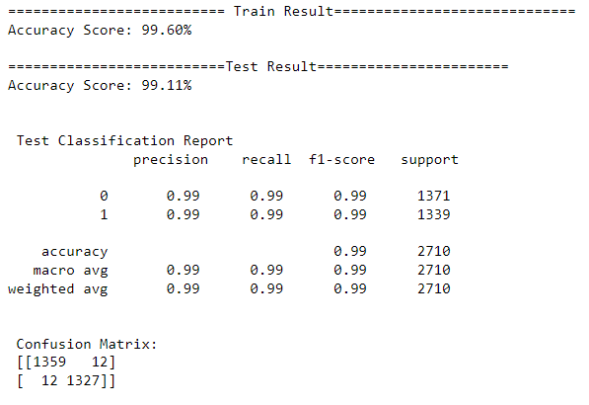
XGBClassifier:

Slide 20
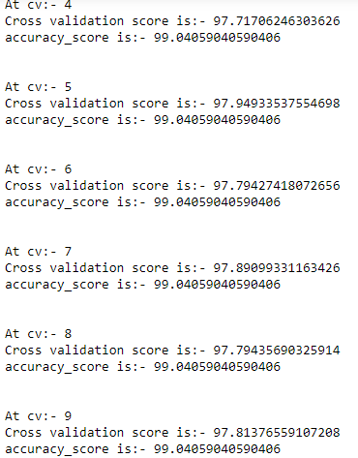
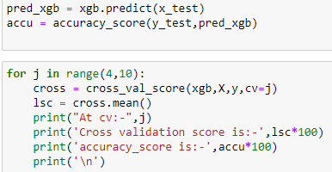
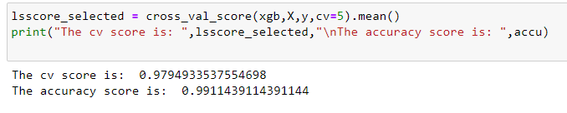
Cross Validation For XGBClassifier:

Slide 21
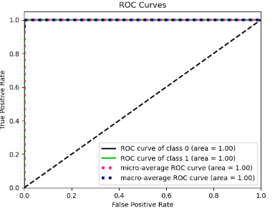
ROC AUC Curve The AUC-ROC curve helps us visualize how well our machine learning classifier is performing. ROC curves are appropriate when the observations are balanced between each class. Logistic Regression:

Slide 22
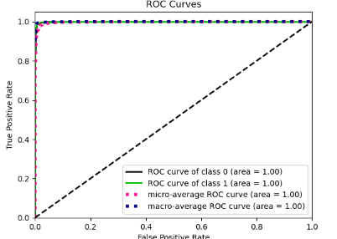
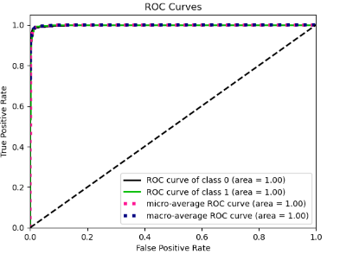
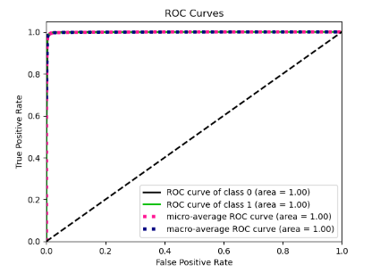
Random Forest Classifier: Complement Naïve Bayes XGBClassifier:

Slide 23
Interpretation of the results Based on comparing the above graphs, Precision, Recall, Accuracy Scores with Cross validation scores, it is determined that Complement Naive Bayes Classifier is the best model for the dataset.

Slide 24
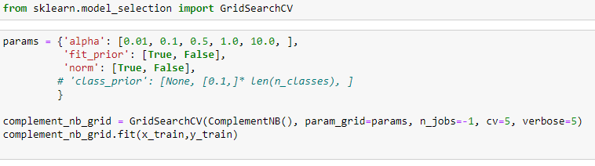
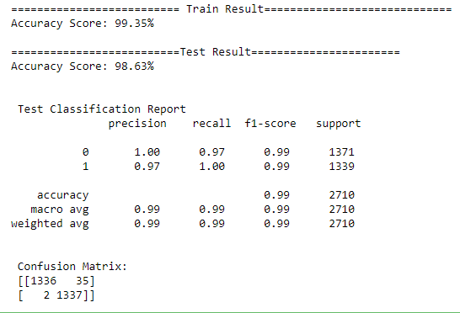
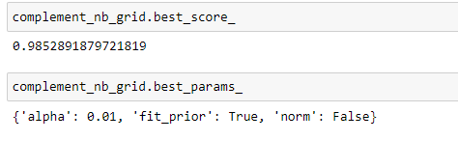
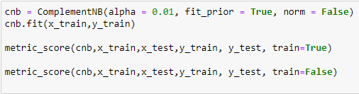
Hyperparameter Tuning

Slide 25
Conclusions:
The final model performed with 98.89% accuracy, Recall score of 0.98. It means that the model is optimized better to predict label whether it is spam email or not.
Spam emails have become a major concern for the internet community as it poses a threat to integrity and productivity of the users. Filtering of email is very much necessary for email communication. The accurate detection of spam emails is a big issue and many filtering methods have been proposed by various research
Not only does spam filtering help keep garbage out of email inboxes, it helps with the quality of life of business emails because they run smoothly and are only used for their desired purpose.
So that we need to do spam filtering so user more user friendly. From above model building we got the Complement Naive Bayes Classifier is a best model deciding whether the emails have spam or not.

Slide 26


